Slide 1
LECTURE ID :18B11CS311STL04 PROGRAMME : B.Tech. COURSE TITLE : Computer Networks and Internet of Things LECTURE TITLE : Routing Principle (Part II) FACULTY NAME : Dr. Shobhit Tyagi

Slide 2
Routing Principle (Part II)
By Dr. Shobhit Tyagi Dept. of CSE & IT JIIT, NOIDA

Slide 3
Topics of Today’s Lecture
Network IP & Subnetting & Supernetting
IPv4 - Subnetting
IPv4 - Supernetting

Slide 4
Network IP and Subnetting and Supernetting
IP stands for internet protocol. It is a protocol defined in the TCP/IP model used for sending the packets from source to destination. The main task of IP is to deliver the packets from source to the destination based on the IP addresses available in the packet headers. IP defines the packet structure that hides the data which is to be delivered as well as the addressing method that labels the datagram with a source and destination information.

Slide 5
Network IP and Subnetting and Supernetting
An IP protocol provides the connectionless service, which is accompanied by two transport protocols, i.e., TCP/IP and UDP/IP, so internet protocol is also known as TCP/IP or UDP/IP.
The first version of IP (Internet Protocol) was IPv4. After IPv4, IPv6 came into the market, which has been increasingly used on the public internet since 2006.

Slide 6

Network IP and Subnetting and Supernetting
Say I want to send you a mail then I must have your home address.
Similarly, your computer too needs an address so that other computers on the internet can communicate with each other without the confusion of delivering information to someone else’s computer. And that is why each computer in this world has a unique IP Address.
or
An IP address is a unique address that is used to identify computers or nodes on the internet.

Slide 7
Network IP and Subnetting and Supernetting
This address is just a string of numbers written in a certain format. It is generally expressed in a set of numbers for example 192.155.12.1.
Here each number in the set is from 0 to 255 range. or we can say that a full IP address ranges from 0.0.0.0 to 255.255.255.255.
And these IP addresses are assigned by IANA(known as Internet Corporation For Internet Assigned Numbers Authority).

Slide 8
Network IP and Subnetting and Supernetting
Types of IP Address
IP Address is of two types:
IPv4:
Internet Protocol version 4. It consists of 4 numbers separated by dots. Each number can be from 0-255 in decimal numbers.
But computers do not understand decimal numbers, they instead change them to binary numbers which are only 0 and 1.
Therefore, in binary, this (0-255) range can be written as (00000000 – 11111111).

Slide 9
Network IP and Subnetting and Supernetting
IPv4:
Since each number N can be represented by a group of 8-digit binary digits.
So, a whole IPv4 binary address can be represented by 32-bits of binary digits. In IPv4, a unique sequence of bits is assigned to a computer,
so a total of (2^32) devices approximately = 4,294,967,296 can be assigned with IPv4.
IPv4 can be written as: 189.123.123.90

Slide 10
Network IP and Subnetting and Supernetting
Classes of IPv4 Address:
There are around 4.3 billion IPv4 addresses and managing all those addresses without any scheme is next to impossible.
Let’s understand it with a simple example. If you have to find a word from a language dictionary, how long will it take?
Usually, you will take less than 5 minutes to find that word. You are able to do this because words in the dictionary are organized in alphabetical order.

Slide 11
Network IP and Subnetting and Supernetting
Classes of IPv4 Address:
If you have to find out the same word from a dictionary that doesn’t use any sequence or order to organize the words, it will take an eternity to find the word. If a dictionary with one billion words without order can be so disastrous, then you can imagine the pain behind finding an address from 4.3 billion addresses.
For easier management and assignment IP addresses are organized in numeric order and divided into the following 5 classes :

Slide 12
Network IP and Subnetting and Supernetting
Classes of IPv4 Address:
IP Class | Address Range | Maximum number of networks
Class A | 0-127 | 127 (2⁷-1)
Class B | 128-191 | 16384
Class C | 192-223 | 2097152
Class D | 224-239 | Reserve for multitasking
Class E | 240-254 | Reserved for Research and development

Slide 13
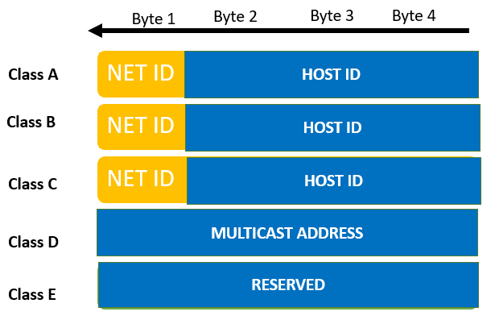
Network IP and Subnetting and Supernetting
 | Byte 1 | Byte 2 | Byte 3 | Byte 4
Class A | NET ID | HOST ID
Class A | NET ID | HOST ID
Class A | NET ID | HOST ID
Class A | Multicast address
Class A | Reserved

Slide 14
Network IP and Subnetting and Supernetting
2. IPv6:
There is a problem with the IPv4 address.
With IPv4, we can connect only the above number of 4 billion devices uniquely, and apparently, there are much more devices in the world to be connected to the internet.
So, gradually we are making our way to IPv6 Address which is a 128-bit IP address.

Slide 15
Network IP and Subnetting and Supernetting
2. IPv6:
IPv6 can be written as:
2011:0bd9:75c5:0000:0000:6b3e:0170:8394

Slide 16
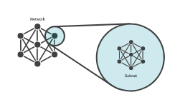
IPv4 - Subnetting
Network
Subnet

Slide 17
IPv4 - Subnetting
What is a subnet ?
A subnet, or subnetwork, is a network inside a network. Subnets make networks more efficient. Through subnetting, network traffic can travel a shorter distance without passing through unnecessary routers to reach its destination.

Slide 18
IPv4 - Subnetting
Why is subnetting necessary ?
As the previous example illustrates, the way IP addresses are constructed makes it relatively simple for Internet routers to find the right network to route data into.
However, in a Class A network (for instance), there could be millions of connected devices, and it could take some time for the data to find the right device. This is why subnetting comes in handy: subnetting narrows down the IP address to usage within a range of devices.
Because an IP address is limited to indicating the network and the device address, IP addresses cannot be used to indicate which subnet an IP packet should go to. Routers within a network use something called a subnet mask to sort data into subnetworks.
Kindly reduce the text if possible

Slide 19
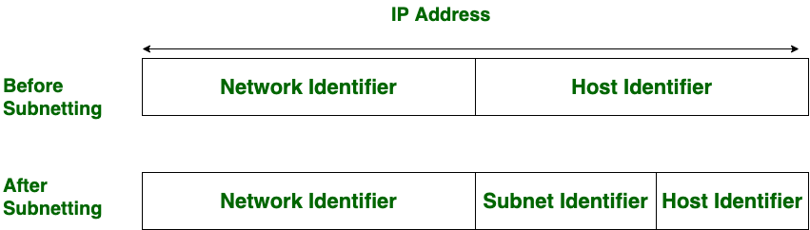
IPv4 - Subnetting
IP Address
Before
Subnetting
Host Identifier
Network Identifier
After
Subnetting
Network Identifier
Subnet Identifier
Host Identifier

Slide 20
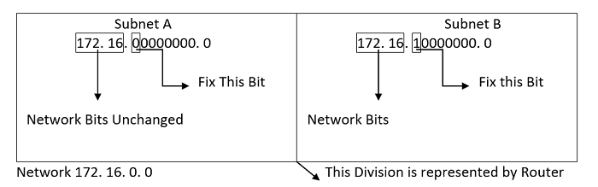
IPv4 - Subnetting
For the construction of the subnets, we usually check the MSB (Most Significant Bit) bits of the host ID and if found wrong we make it right. In order to create two network subnets, we fix one of the host's MSB (Most Significant Bit) bits in the table below. We are unable to alter network bits since doing so would alter the entire network.
Subnet A | Subnet B
172.16
.
0 0000000.0
172.16
.
0 0000000.0
Fix This Bit
Fix This Bit
Network Bits Unchanged
Network Bits
Network 172. 16.0. 0
The Division is represented by Router

Slide 21
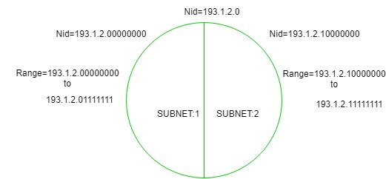
IPv4 - Subnetting
We need a subnet mask to identify a subnet, which is created by substituting the number "1" for each Network ID bit and the amount of bits we reserve for Host ID to create the subnet. A data packet from the internet is intended to be forwarded to the specified subnet network using the subnet mask.
The network can be divided into two parts: To divide a network into two parts, you need to choose one bit for each Subnet from the host ID part.
Kindly reduce the text if possible

Slide 22
IPv4 - Subnetting
Nid = 193.1.2.0
Nid = 193.1.200000000
Nid = 193.1.2.10000000
Range = 193.1.2.00000000
to
193.1.2.01111111
Range = 193.1.2.00000000
to
193.1.2.01111111
Subnet : 1
Subnet : 2
Kindly reduce the text if possible

Slide 23
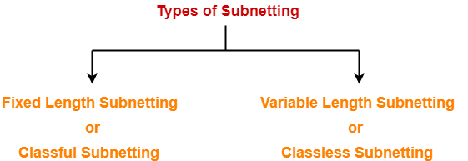
IPv4 - Subnetting
Types of Subnetting
Fixed Length Subnetting
or
Classful Subnetting
Variable Length Subnetting
or
Classless Subnetting

Slide 24
IPv4 - Subnetting
1. Fixed Length Subnetting-
Fixed length subnetting also called as classful subnetting divides the network into subnets where-
All the subnets are of same size.
All the subnets have equal number of hosts.
All the subnets have same subnet mask.

Slide 25
IPv4 - Subnetting
2. Variable Length Subnetting-
Variable length subnetting also called as classless subnetting divides the network into subnets where-
All the subnets are not of same size.
All the subnets do not have equal number of hosts.
All the subnets do not have same subnet mask.

Slide 26
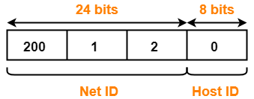
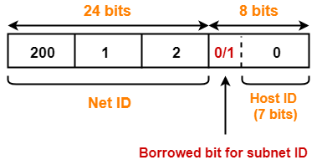
IPv4 - Subnetting
24 bits
8 bits
24 bits
8 bits
200
1
2
0
200
1
2
0
0/1
Net ID
Host ID
Net ID
Host ID (7 bits)
Borrowed bit for subnet ID
If borrowed bit = 0, then it represents the first subnet.
If borrowed bit = 1, then it represents the second subnet.
IP Address of the two subnets are-
200.1.2.00000000 = 200.1.2.0
200.1.2.10000000 = 200.1.2.128

Slide 27
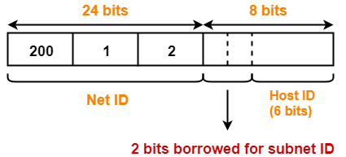
IPv4 - Subnetting
Example:
Consider-
We have a big single network having IP Address 200.1.2.0.
We want to do subnetting and divide this network into 4 subnets.
Clearly, the given network belongs to class C.
24 bits
8 bits
24 bits
8 bits
200
1
2
0
200
1
2
0
Net ID
Host ID
Net ID
Host ID (6 bits)
2 bits Borrowed for subnet ID

Slide 28
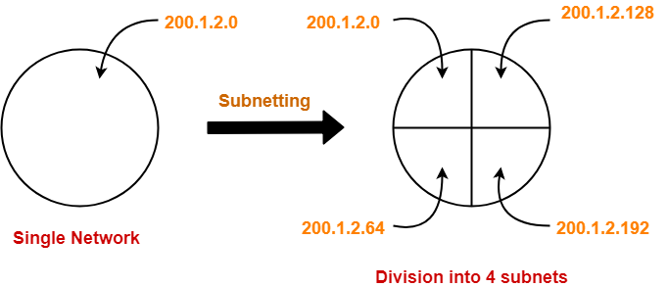
IPv4 - Subnetting
If borrowed bits = 00, then it represents the 1st subnet.
If borrowed bits = 01, then it represents the 2nd subnet.
If borrowed bits = 10, then it represents the 3rd subnet.
If borrowed bits = 11, then it represents the 4th subnet.
IP Address of the four subnets are-
200.1.2.00000000 = 200.1.2.0
200.1.2.01000000 = 200.1.2.64
200.1.2.10000000 = 200.1.2.128
200.1.2.11000000 = 200.1.2.192
200.1.2.0
200.1.2.0
200.1.2.128
Subnetting
200.1.2.64
200.1.2.192
Single Network
Division into 4 subnets

Slide 29
IPv4 - Subnetting
How to calculate Subnet Mask ?
For any given IP Address, the subnet mask is calculated by setting all the bits reserved :
for network ID part and subnet ID part to 1
for host ID part to 0

Slide 30
IPv4 - Subnetting
How to calculate subnet mask for any given network -
Example:
Consider we have a network having IP Address 200.1.2.0.
Clearly, this IP Address belongs to class C
In class C-
24 bits are reserved for the Network ID part.
8 bits are reserved for the Host ID part.
Subnet mask is obtained-

Slide 31
IPv4 - Subnetting
By setting the first 24 bits to 1.
By setting the remaining 8 bits to 0.
So, Subnet mask
= 11111111.11111111.11111111.00000000
= 255.255.255.0

Slide 32
IPv4 - Subnetting
Problem:
If the subnet mask 255.255.255.128 belongs to class C, find :-
Number of subnets
Number of hosts in each subnet
Solution-
Given subnet mask
= 255.255.255.128
= 11111111.11111111.11111111.10000000

Slide 33
IPv4 - Subnetting
Since 25 bits contain the value 1 and 7 bits contain the value 0, so-
Number of Net ID bits + Number of Subnet ID bits = 25
Number of Host ID bits = 7
Now, It is given that subnet mask belongs to class C.
So, Number of Net ID bits = 24.
Substituting in the above equation, we get-
Number of Subnet ID bits= 25 – 24 = 1

Slide 34
IPv4 - Subnetting
Thus,
Number of subnets = 2^1 = 2
Since number of Host ID bits = 7, so-
Number of hosts per subnet = 2^7 – 2 = 126

Slide 35
IPv4 - Subnetting
Example:
Consider a block of address with starting address 112.78.0.0/16. Find the first and last addresses for each group, if the number and size of the subnets required by them are as given in the input.
Input:
Group-1:
256 subnets, each needs 128 addresses
Group-2:
1024 subnets, each requiring 4 addresses
Group-1:
128 subnets, each consisting of 16 addresses

Slide 36
IPv4 - Subnetting
Output:
Group-1:
First Address : 112.78.0.0 /17
Last Address : 112.78.127.255 /17
Group-2:
First Address : 112.78.128.0 /20
Last Address : 112.78.143.255 / 20
Group-3:
First Address : 112.78.144.0 /21
Last Address : 112.78.151.255 /21

Slide 37
IPv4 - Subnetting
To understand such problems, it is important to understand the procedure to fix the bits in the subnet ID and find the subnet mask for each group of subnets.
Given the Total addresses in the address block,
= 232-16 = 65,536
Understanding the division of address space,
Group-1:
Number of addresses = 256 x 128 = 32, 768

Slide 38
IPv4 - Subnetting
Thus, group 1 occupies 1/2 of the addresses in the block. So, 1 bit is fixed to identify this half and the Subnet Mask becomes /17.
Similarly for Group-2, a total of 4 bits are fixed and the Subnet Mask becomes /20.
And, for Group-3, a total of 5 bits are fixed and subnet mask becomes /21.
Then using Method 2 mentioned above, the respective starting and ending addresses can be found.

Slide 39
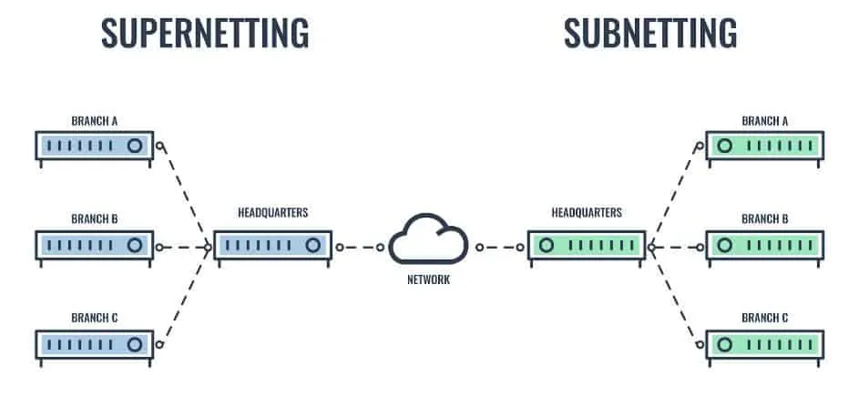
IPv4 - Supernetting
Supernetting
Subnetting
Branch A
Branch A
|||||||
|||||||
Branch B
Branch B
Headquarters
Headquarters
|||||||
|||||||
|||||||
|||||||
Network
Branch C
Branch C
|||||||
|||||||

Slide 40
IPv4 - Supernetting
Supernetting is the opposite of Subnetting. In subnetting, a single big network is divided into multiple smaller subnetworks. In Supernetting, multiple networks are combined into a bigger network termed as a Supernetwork or Supernet.
Supernetting is mainly used in Route Summarization, where routes to multiple networks with similar network prefixes are combined into a single routing entry, with the routing entry pointing to a Super network, encompassing all the networks. This in turn significantly reduces the size of routing tables and also the size of routing updates exchanged by routing protocols.
Kindly reduce the text if possible

Slide 41
IPv4 - Supernetting
How to Supernet a Network?
All the networks are not considered suitable networks for aggregation. Some rules are defined for Supernetting the network. The network must follow below given three rules for aggregation.
Contiguous: All the networks that are to be aggregated must be contiguous.
Same Size: All the networks must have the same size in the power of 2.
Divisibility: ID of the first network must be zero or must be divisible by the block size.

Slide 42
IPv4 - Supernetting
Now let us understand the rules of aggregation by taking an example. Suppose four networks are having the network ID 201.1.0.0, 201.1.1.0, 201.1.2.0, and 201.1.3.0. Now let us check if these networks can be aggregated or not.
Rule 1: Contiguous- As we can identify from IP addresses that these are class C networks. The first network range is from 201.1.0.0 To 201.1.0.255. The second network range starts from 201.1.2.0. The starting address of the second network is obtained by adding 1 to the last network starting IP address. In this way, we will check all network IP addresses, and that all are contiguous.
Rule2: Same Size- As all the given IP addresses belong to class C and every network has 2^8=256 hosts.
Kindly reduce the text if possible

Slide 43
IPv4 - Supernetting
Rule3: Divisibility- IP address of the first network must be divisible by the network's total size. The total size of the network in our example is 4∗2^8=2^10. When we divide the starting IP address with the network size, then we get the last 10 bits as a remainder. For making the IP address divisible by the size, the last ten digits must be zero. A binary representation of the first IP address of the above example is given below: 11001001.00000001.00000000. 00000000
Here last ten bits are zero. So it can be divisible by the size of the network. So all three conditions are satisfied for the IP addresses given in the example. These four networks can be combined to form a supernet. The supernet ID or the network ID for all four networks will be 201.1.0.0.
Kindly reduce the text if possible

Slide 44
IPv4 - Supernetting
How to supernet a network ?
Combining these networks into one network: (A summarized route)
• 192.168.0.0/24
• 192.168.1.0/24
• 192.168.2.0/24
• 192.168.3.0/24
Step 1: Write all the IP Addresses in binary like so:
• 192.168.0.0/24
11000000.10101000.00000000.00000000
• 192.168.1.0/24
11000000.10101000.00000001.00000000

Slide 45
IPv4 - Supernetting
Step 1: Write all the IP Addresses in binary like so:
• 192.168.2.0/24
11000000.10101000.00000010.00000000
• 192.168.3.0/24
11000000.10101000.00000011.00000000

Slide 46
IPv4 - Supernetting
Step 2: Find matching bits from left to right
11000000.10101000.000000 00.00000000
11000000.10101000.000000 01.00000000
11000000.10101000.000000 10.00000000
11000000.10101000.000000 11.00000000

Slide 47
IPv4 - Supernetting
Step 3: Re write the matching numbers and add the remaining zeros, because you are converting
network bits into host bits. This will be your NEW NETWORK ID, the route that you will be
advertising. (A summarized route)
11000000.10101000.00000000.00000000 = 192.168.0.0

Slide 48
IPv4 - Supernetting
Step 4: Find the new subnet mask. Put “1s” in the matching networking part, and all zeros in the
host part.
11111111.11111111.11111100.00000000
This your new subnet mask 255.255.252.0
• Your new summarized route is 192.168.0.0/22

Slide 49
Thank You

